Slide 1

Adaptive Congestion-Control Simulator and Performance Analyzer
Mini-project presentation
Computer Networks Laboratory (CSE20110)
Department of Computer Engineering and Technology
Neel Rede – 1272250836
Arya Kale – 1262241076
Parth Agrawal – 1262241844
Saumya Shah – 1262242587
Group 2, Panel K, Batch iOS
Faculty: Dr. Swati
Academic Year: 2026–2027
Computer Networks Laboratory CSE20110
Notes:
Suggested time: 15 seconds. Replace all bracketed placeholders and prompts with your own project details. Keep explanations brief. Total time across slides 1–7 is 5 minutes, including the demonstration. Slide 8 is for reference during questions. Logo source: https://mitwpu.edu.in/uploads/images/MIT-WPU-logo-1.webp. Introduce only the title and team; do not read every PRN.

Slide 2
Problem and Objectives
Problem:
What networking problem does the project solve?: Studying TCP congestion-control algorithms (Tahoe, Reno, AIMD) theoretically makes it difficult to visualize and compare how senders adjust transmission behavior during changing loss conditions and RTTs.
Who needs the solution, and what is the scope?: Students and educators in computer networking need a lightweight tool. Scope covers a round-based simulator in Python/Streamlit comparing congestion windows, throughput, loss rates, and recovery behaviors without requiring physical network hardware or raw socket implementation.
Computer Networks Laboratory CSE20110
Notes:
Suggested time: 40 seconds. Replace all bracketed placeholders and prompts with your own project details. Keep explanations brief. Total time across slides 1–7 is 5 minutes, including the demonstration. Slide 8 is for reference during questions.

Slide 3
Problem and Objectives
Objectives:
Implement simplified, round-based models of TCP Tahoe, TCP Reno, and AIMD algorithms with configurable network parameters (Loss %, RTT, Initial CWND, Seed).
Compare and visualize algorithm dynamics, congestion window transitions, and performance metrics via interactive Plotly charts and tabular summaries.
Validate simulator logic with a 20-check automated test suite and enable CSV/JSON data exports for offline analysis.
Computer Networks Laboratory CSE20110
Notes:
Suggested time: 40 seconds. Replace all bracketed placeholders and prompts with your own project details. Keep explanations brief. Total time across slides 1–7 is 5 minutes, including the demonstration. Slide 8 is for reference during questions.

Slide 4
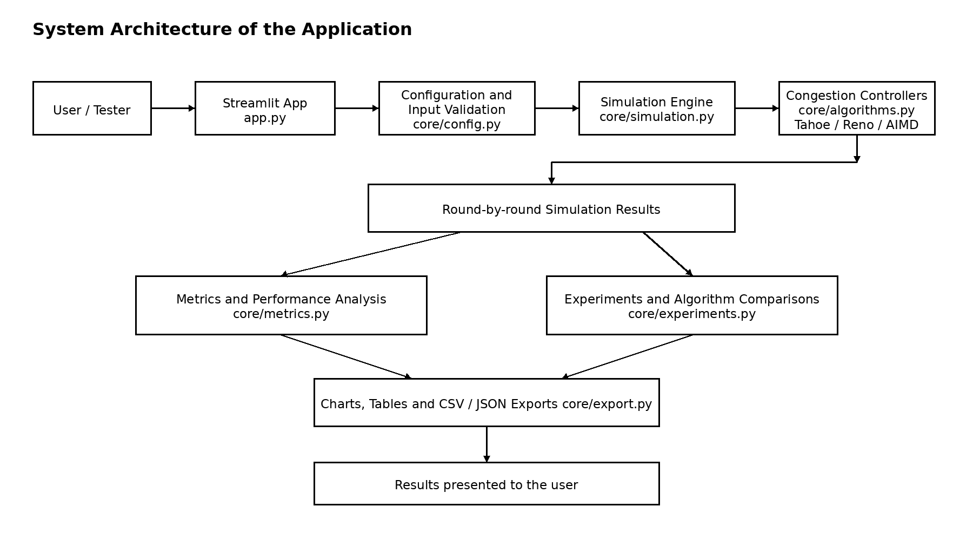
Proposed Design and Tools
Computer Networks Laboratory CSE20110
Notes:
Suggested time: 45 seconds. Replace all bracketed placeholders and prompts with your own project details. Keep explanations brief. Total time across slides 1–7 is 5 minutes, including the demonstration. Slide 8 is for reference during questions. Explain the diagram and only the most relevant design decisions. Use an actual project diagram with readable labels.

Slide 5
Proposed Design and Tools
Tools: Python 3.12, Streamlit (Interactive Dashboard UI), Pandas (Data logging & metric processing), Plotly (Dynamic visualization plots), JSON/CSV libraries.
Protocols: Simplified models of TCP Tahoe (CWND reset to 1 on loss), TCP Reno (Fast Recovery on 3-dup ACK, Reset on Timeout), and AIMD (Additive Increase +1, Multiplicative Decrease /2).
Addressing: [Key subnet, host or port details]
Addressing: Logical simulation model operating on a per-Round Trip Time (RTT) step basis. No physical IP/MAC addressing or socket interface required.
Computer Networks Laboratory CSE20110
Notes:
Suggested time: 45 seconds. Replace all bracketed placeholders and prompts with your own project details. Keep explanations brief. Total time across slides 1–7 is 5 minutes, including the demonstration. Slide 8 is for reference during questions. Explain the diagram and only the most relevant design decisions. Use an actual project diagram with readable labels.

Slide 6
Implementation and Working
1. User Selects Algorithm & Configures Parameters ]
│
▼
2. Application Validates Configuration (core/config.py) ]
│
▼
3. Initialize Congestion Control State (core/algorithms.py) ]
│
▼
4. Loop Through Simulation Rounds (core/simulation.py) ]
│
├─► 5. Generate Packet Delivery / Loss Outcomes ]
│
└─► 6. Update Congestion Window (Tahoe / Reno / AIMD) ]
│
▼
7. Store Round-by-Round Results in Dataframe ]
│
▼
8. Calculate Metrics: Throughput, Loss Rate, CWND (core/metrics.py) ]
│
▼
9. Render Plotly Charts, Data Tables & CSV/JSON Exports ]
Computer Networks Laboratory CSE20110
55 seconds
Notes:
Suggested time: 55 seconds. Replace all bracketed placeholders and prompts with your own project details. Keep explanations brief. Total time across slides 1–7 is 5 minutes, including the demonstration. Slide 8 is for reference during questions.

Slide 7
Implementation and Working
Implementation:
app.py: Streamlit controls, chart panels, validation UI.
core/algorithms.py: State transition logic for Tahoe, Reno, and AIMD.
core/simulation.py: Step-by-step round loop processing packet delivery/loss outcomes based on uniform seed probabilities.
core/metrics.py: Calculates throughput, packet loss percentage, average cwnd, and recovery time.
Computer Networks Laboratory CSE20110
55 seconds
Notes:
Suggested time: 55 seconds. Replace all bracketed placeholders and prompts with your own project details. Keep explanations brief. Total time across slides 1–7 is 5 minutes, including the demonstration. Slide 8 is for reference during questions.

Slide 8
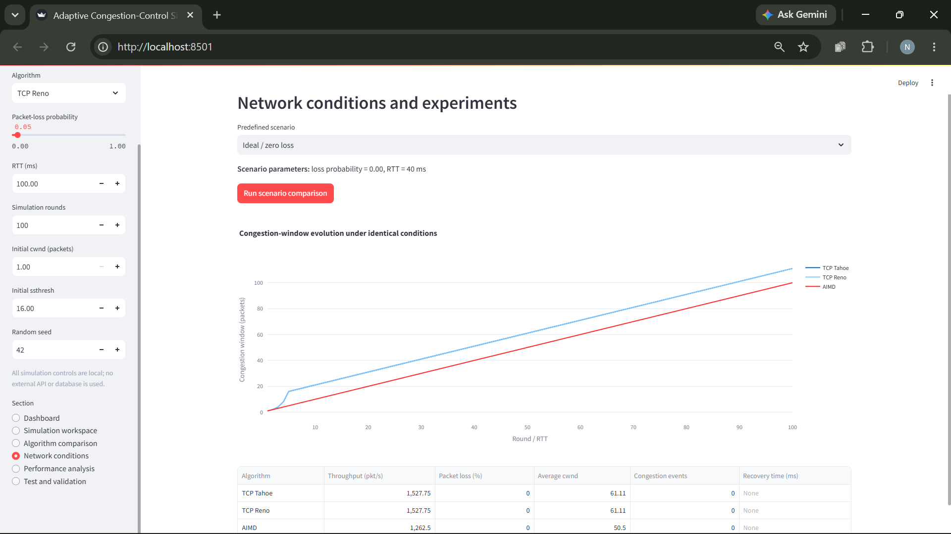
Testing and Results
Computer Networks Laboratory CSE20110
50 seconds
Notes:
Suggested time: 50 seconds. Replace all bracketed placeholders and prompts with your own project details. Keep explanations brief. Total time across slides 1–7 is 5 minutes, including the demonstration. Slide 8 is for reference during questions. Show actual evidence. Explain the output and mention any failed or partial tests. Do not invent performance figures.

Slide 9
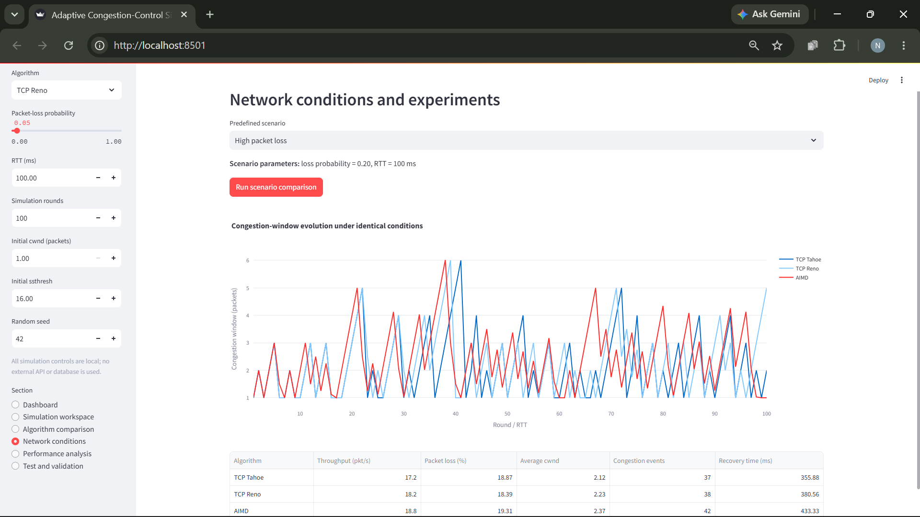
Testing and Results
Computer Networks Laboratory CSE20110
50 seconds
Notes:
Suggested time: 50 seconds. Replace all bracketed placeholders and prompts with your own project details. Keep explanations brief. Total time across slides 1–7 is 5 minutes, including the demonstration. Slide 8 is for reference during questions. Show actual evidence. Explain the output and mention any failed or partial tests. Do not invent performance figures.

Slide 10
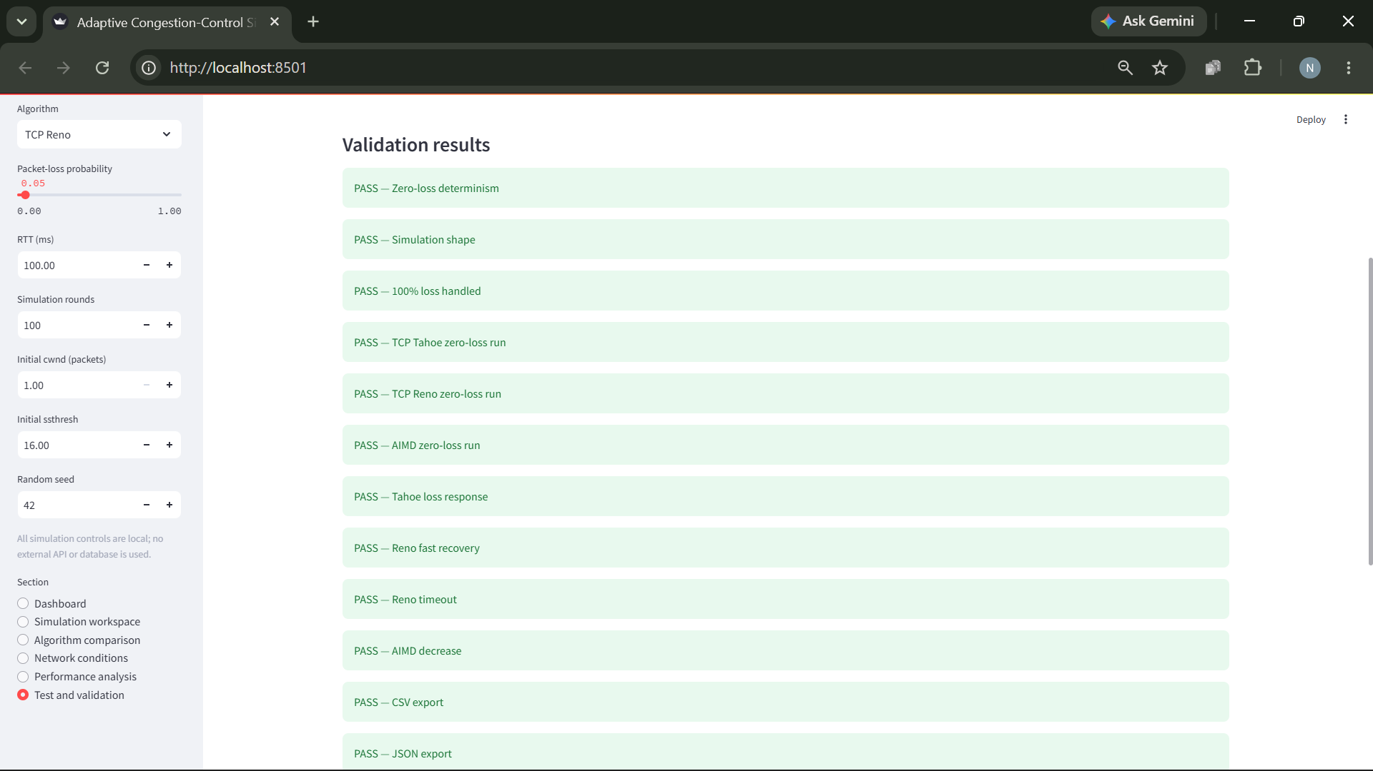
Testing and Results
Computer Networks Laboratory CSE20110
50 seconds
Notes:
Suggested time: 50 seconds. Replace all bracketed placeholders and prompts with your own project details. Keep explanations brief. Total time across slides 1–7 is 5 minutes, including the demonstration. Slide 8 is for reference during questions. Show actual evidence. Explain the output and mention any failed or partial tests. Do not invent performance figures.

Slide 11
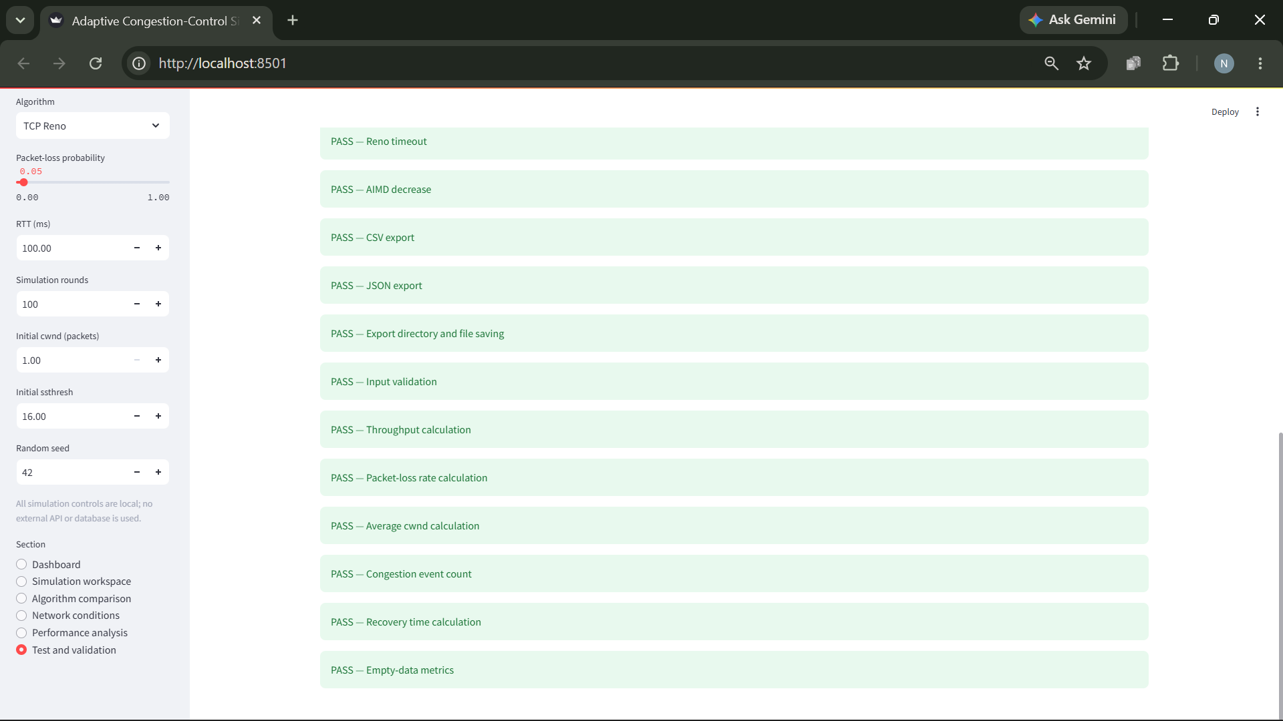
Testing and Results
Computer Networks Laboratory CSE20110
50 seconds
Notes:
Suggested time: 50 seconds. Replace all bracketed placeholders and prompts with your own project details. Keep explanations brief. Total time across slides 1–7 is 5 minutes, including the demonstration. Slide 8 is for reference during questions. Show actual evidence. Explain the output and mention any failed or partial tests. Do not invent performance figures.

Slide 12
Testing and Results
Test: Run 20 automated unit checks across extreme conditions (0% loss, 100% loss), algorithm responses, export format validity, and metric calculations.
Expected: Zero-loss determinism across runs, Reno maintaining higher throughput than Tahoe during 3-dup ACK events, and valid JSON/CSV outputs.
Observed: All 20/20 automated checks passed successfully. Under ideal conditions (0% loss), Tahoe and Reno yield identical growth curves. Under moderate loss, Reno recovers faster than Tahoe due to Fast Recovery.
Computer Networks Laboratory CSE20110
50 seconds
Notes:
Suggested time: 50 seconds. Replace all bracketed placeholders and prompts with your own project details. Keep explanations brief. Total time across slides 1–7 is 5 minutes, including the demonstration. Slide 8 is for reference during questions. Show actual evidence. Explain the output and mention any failed or partial tests. Do not invent performance figures.

Slide 13
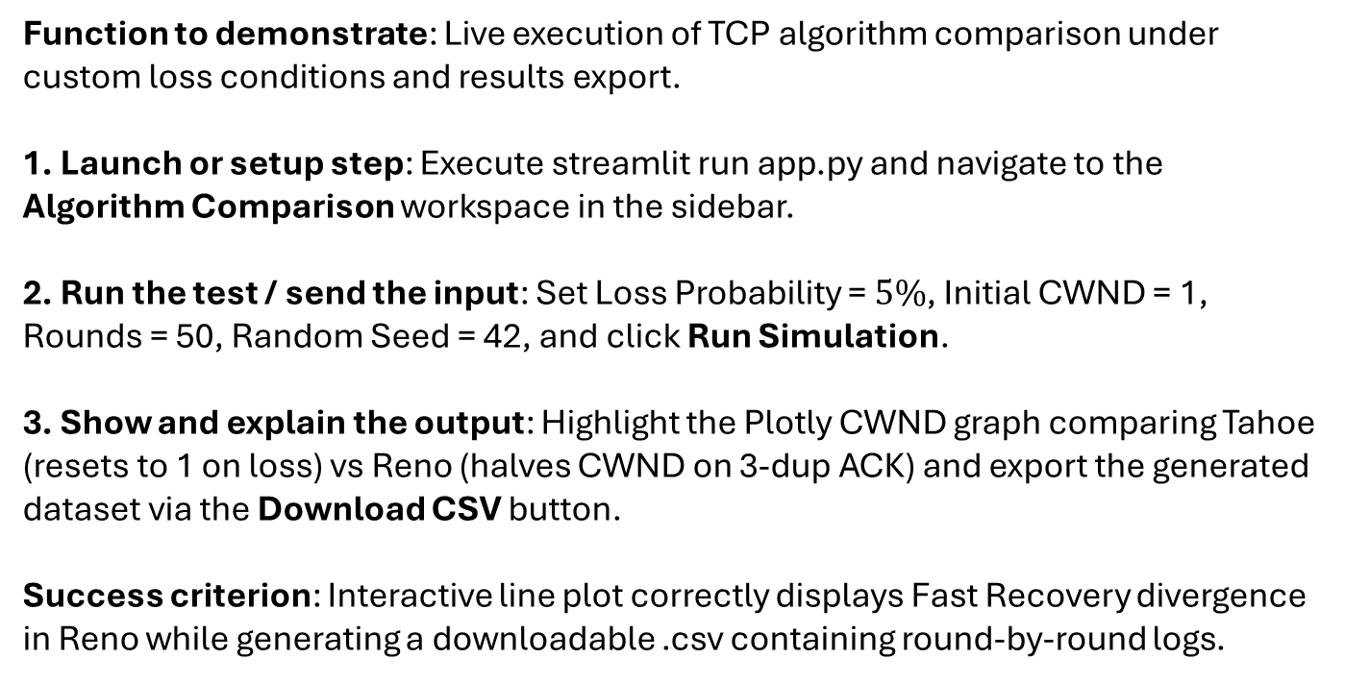
Working Demonstration
Function to demonstrate: Live execution of TCP algorithm comparison under custom loss conditions and results export.
1. Launch or setup step: Execute streamlit run app.py and navigate to the Algorithm Comparison workspace in the sidebar.
2. Run the test / send the input: Set Loss Probability = $5\%$, Initial CWND = 1, Rounds = 50, Random Seed = 42, and click Run Simulation.
3. Show and explain the output: Highlight the Plotly CWND graph comparing Tahoe (resets to 1 on loss) vs Reno (halves CWND on 3-dup ACK) and export the generated dataset via the Download CSV button.
Success criterion: Interactive line plot correctly displays Fast Recovery divergence in Reno while generating a downloadable .csv containing round-by-round logs.
Computer Networks Laboratory CSE20110
65 seconds
Notes:
Suggested time: 65 seconds. Replace all bracketed placeholders and prompts with your own project details. Keep explanations brief. Total time across slides 1–7 is 5 minutes, including the demonstration. Slide 8 is for reference during questions. Prepare the project before the timer starts. Keep the demo to about one minute. Keep a screenshot or short recording ready as a backup, and identify it as recorded evidence if used.

Slide 14
Conclusion and Contributions
Outcome: Successfully developed a modular Python/Streamlit simulator that accurately models, compares, and visualizes TCP Tahoe, Reno, and AIMD behaviors without physical network hardware.
Application: Educational tool for computer network courses to demonstrate congestion control dynamics interactively.
Limitation: Uses a logical round-based model with probabilistic loss heuristics rather than real TCP packet header exchanges, physical queues, or Wireshark packet captures.
Future scope: Add packet-level queueing models (e.g., DropTail, RED) and support interactive bandwidth bottleneck configuration.
Computer Networks Laboratory CSE20110
30 seconds
Notes:
Suggested time: 30 seconds. Replace all bracketed placeholders and prompts with your own project details. Keep explanations brief. Total time across slides 1–7 is 5 minutes, including the demonstration. Slide 8 is for reference during questions.

Slide 15
Conclusion and Contributions
Project planning and problem definition - Neel Rede
Congestion-control algorithm implementation - Arya Kale
Simulation engine and configuration validation - Parth Agrawal
Streamlit interface and visualizations - Parth Agrawal
Network scenarios and algorithm comparisons - Saumya Shah
Performance metric calculations - Saumya Shah
Testing and validation - Neel Rede
CSV/JSON export functionality - Neel Rede
README and demonstration - Neel Rede
Architecture and technical documentation - Arya Kale
Computer Networks Laboratory CSE20110
30 seconds
Notes:
Suggested time: 30 seconds. Replace all bracketed placeholders and prompts with your own project details. Keep explanations brief. Total time across slides 1–7 is 5 minutes, including the demonstration. Slide 8 is for reference during questions.

Slide 16
References
[1]: V. Jacobson, "Congestion avoidance and control," ACM SIGCOMM Computer Communication Review, vol. 18, no. 4, pp. 314–329, 1988.
[2]: M. Allman, V. Paxson, and E. Blanton, "TCP Congestion Control," RFC 5681, IETF, 2009.
[3]: J. F. Kurose and K. W. Ross, Computer Networking: A Top-Down Approach, 8th ed. Boston, MA: Pearson, 2021.
Github: https://github.com/Programmerboi2006/Adaptive-Congestion-Control-Simulator-Group-2
Computer Networks Laboratory CSE20110
Backup slide
Notes:
Suggested time: Backup slide. Replace all bracketed placeholders and prompts with your own project details. Keep explanations brief. Total time across slides 1–7 is 5 minutes, including the demonstration. Slide 8 is for reference during questions.

